Slide 1
Thrashing
Thrashing is directly linked with the degree of multi level programming.
In case, if the page fault and swapping happens very frequently at a higher rate, then the operating system has to spend more time swapping these pages.
This state in the operating system is termed thrashing. Because of thrashing the CPU utilization is going to be reduced.
Let's understand by an example, if any process does not have the number of frames that it needs to support pages in active use then it will quickly page fault.
And at this point, the process must replace some pages. As all the pages of the process are actively in use, it must replace a page that will be needed again right away.
Consequently, the process will quickly fault again, and again, and again, replacing pages that it must bring back in immediately. This high paging activity by a process is called thrashing.
During thrashing, the CPU spends less time on some actual productive work spend more time swapping.

Slide 2
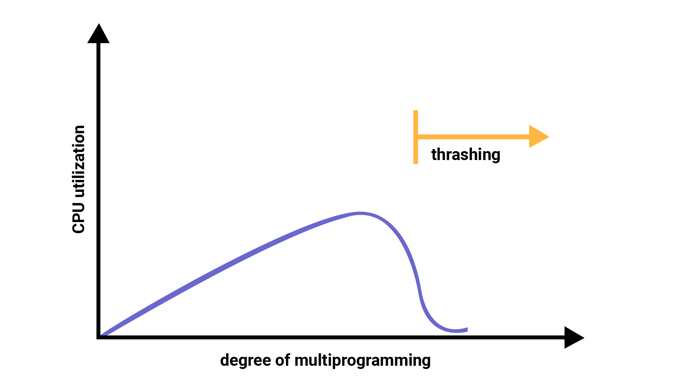

Slide 3
Causes of Thrashing
Thrashing affects the performance of execution in the Operating system. Also, thrashing results in severe performance problems in the Operating system.
When the utilization of CPU is low, then the process scheduling mechanism tries to load many processes into the memory at the same time due to which degree of Multiprogramming can be increased.
Now in this situation, there are more processes in the memory as compared to the available number of frames in the memory. Allocation of the limited amount of frames to each process.
Whenever any process with high priority arrives in the memory and if the frame is not freely available at that time then the other process that has occupied the frame is residing in the frame will move to secondary storage and after that this free frame will be allocated to higher priority process.

Slide 4
We can also say that as soon as the memory fills up, the process starts spending a lot of time for the required pages to be swapped in.
Again the utilization of the CPU becomes low because most of the processes are waiting for pages.
Thus a high degree of multiprogramming and lack of frames are two main causes of thrashing in the Operating system.

Slide 5
Effect of Thrashing
At the time, when thrashing starts then the operating system tries to apply either the Global page replacement Algorithm or the Local page replacement algorithm.
Global Page Replacement
The Global Page replacement has access to bring any page, whenever thrashing found it tries to bring more pages.
Actually, due to this, no process can get enough frames and as a result, the thrashing will increase more and more.
Thus the global page replacement algorithm is not suitable whenever thrashing happens.
Local Page Replacement
Unlike the Global Page replacement, the local page replacement will select pages which only belongs to that process.
Due to this, there is a chance of a reduction in the thrashing. As it is also proved that there are many disadvantages of Local Page replacement.
Thus local page replacement is simply an alternative to Global Page replacement.

Slide 6
Techniques used to handle the thrashing
As we have already told you the Local Page replacement is better than the Global Page replacement but local page replacement has many disadvantages too, so it is not suggestible. Thus given below are some other techniques that are used:
Working-Set Model
This model is based on the assumption of the locality. It makes the use of the parameter in order to define the working-set window.
The main idea is to examine the most recent? page reference. What locality is saying, the recently used page can be used again, and also the pages that are nearby this page will also be used.

Slide 7
1. Working Set
The set of the pages in the most recent? page reference is known as the working set. If a page is in active use, then it will be in the working set. In case if the page is no longer being used then it will drop from the working set ? times after its last reference.
The working set mainly gives the approximation of the locality of the program.
The accuracy of the working set mainly depends on? what is chosen?
This working set model avoids thrashing while keeping the degree of multiprogramming as high as possible.

Slide 8
2.Page Fault Frequency
There is another technique that is used to avoid thrashing and it is Page Fault Frequency(PFF) and it is a more direct approach.
The main problem is how to prevent thrashing. As thrashing has a high page fault rate and also we want to control the page fault rate.
When the Page fault is too high, then we know that the process needs more frames.
Conversely, if the page fault-rate is too low then the process may have too many frames.
We can establish upper and lower bounds on the desired page faults.
If the actual page-fault rate exceeds the upper limit then we will allocate the process to another frame.
And if the page fault rate falls below the lower limit then we can remove the frame from the process.
Thus with this, we can directly measure and control the page fault rate in order to prevent thrashing.

Slide 9
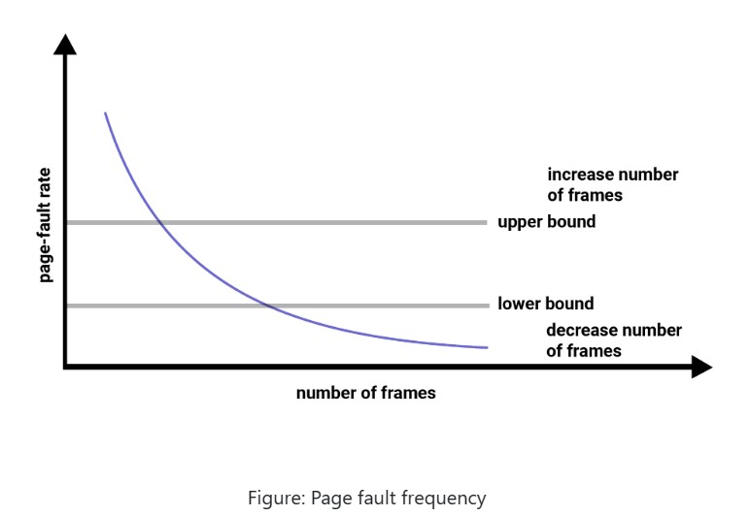

Slide 10
Frame allocation
The main memory of the operating system is divided into various frames.
The process is stored in these frames, and once the process is saved as a frame, the CPU may run it.
As a result, the operating system must set aside enough frames for each process.
As a result, the operating system uses various algorithms in order to assign the frame.
Demand paging is used to implement virtual memory, an essential operating system feature.
It requires the development of a page replacement mechanism and a frame allocation system.
If you have multiple processes, the frame allocation techniques are utilized to define how many frames to allot to each one.
A number of factors constrain the strategies for allocating frames:

Slide 11
You cannot assign more frames than the total number of frames available.
A specific number of frames should be assigned to each process. This limitation is due to two factors. The first is that when the number of frames assigned drops, the page fault ratio grows, decreasing the process's execution performance. Second, there should be sufficient frames to hold all the multiple pages that any instruction may reference.

Slide 12
There are mainly five ways of frame allocation algorithms in the OS. These are as follows:
Equal Frame Allocation
Proportional Frame Allocation
Priority Frame Allocation
Global Replacement Allocation
Local Replacement Allocation

Slide 13
Equal Frame Allocation
In equal frame allocation, the processes are assigned equally among the processes in the OS.
For example, if the system has 30 frames and 7 processes, each process will get 4 frames. The 2 frames that are not assigned to any system process may be used as a free-frame buffer pool in the system.
Disadvantage
In a system with processes of varying sizes, assigning equal frames to each process makes little sense.
Many allotted empty frames will be wasted if many frames are assigned to a small task.

Slide 14
Proportional Frame Allocation
The proportional frame allocation technique assigns frames based on the size needed for execution and the total number of frames in memory.
The allocated frames for a process pi of size si are ai = (si/S)*m, in which S represents the total of all process sizes, and m represents the number of frames in the system.
Disadvantage
The only drawback of this algorithm is that it doesn't allocate frames based on priority. Priority frame allocation solves this problem.

Slide 15
Priority Frame Allocation
Priority frame allocation assigns frames based on the number of frame allocations and the processes.
Suppose a process has a high priority and requires more frames that many frames will be allocated to it.
Following that, lesser priority processes are allocated.

Slide 16
Global Replacement Allocation
In global replacement, since a process selects a replacement frame from the set of all frames, one process can take a frame from another.
This allows a high priority process to select frames from a low priority process.
This may increase the number of frames allocated to a high priority process.
However, the low priority processes will still suffer from page faults, since the high priority process takes frames from the low priority process.
Therefore, the set of pages in memory for a process may depend on the paging behavior of other processes.

Slide 17
Local Replacement Allocation
In local replacement, each process selects from only its own set of allocated frames.
Therefore, the number of frames allocated to a process does not change.
The set of pages in memory for a process is affected by the paging behavior of only that process. But a process may not be able to use other less used pages of other processes.

Slide 18
THANK YOU..!!!!

